Slide 1


TEXT-BASED HEALTHCARE CHATBOT SUPPORTING ADMITTED PATIENTS
By: Hyderabad India Chapter
https://omdena.com/omdena-chapter-page-india/

Slide 2
Introduction
Web Scraping
Data Preprocessing
NLP Sentiment Analysis
Data Visualization
Dashboard
Chatbot Modeling Rasa Framework
Model Deployment
Conclusion
Future Steps
References
CONTENTS
28/05/2022
TEXT-BASED HEALTHCARE CHATBOT SUPPORTING ADMITTED PATIENTS

Slide 3
TIMELINE (Apr 21st - May 25th, 2022)
Research/Resource exploration
Web Scraping
Data Collection
Data Preprocessing
Model deployment
Dashboard and visualization finishing
Final checkup
Presentation summary
WEEK 1
WEEK 2
WEEK 3
WEEK 4
WEEK 5
Sentiment Analysis Data Collection (twitter)
Dashboard building
Chatbot Modeling

Slide 4
INTRODUCTION
Problem Statement: Often we see anxiety and nervousness while waiting for the answers related to one’s health. This level of anxiety increases as the treatment or procedure lasts long as we keep expecting for results to arrive soon. The concerned person gets anxious, raising various doubts, in mind, regarding post treatment complications and actions required to get to the normal lifestyle. It's very difficult to find the right person to answer these doubts/questions. For e.g. for diet one has to consult a dietician, for post effects consult a different doctor altogether.
Solution: This project focuses on solving this issue by creating solutions in multiple forefronts as below:
Creating a chatbot to help users get answers at their fingertips
Creating a dashboard for users to visualize insights on a particular disease
Displaying the sentiment analysis to users
28/05/2022
TEXT-BASED HEALTHCARE CHATBOT SUPPORTING ADMITTED PATIENTS

Slide 5
WEB SCRAPING
SCRAPE MEDICAL DATA FROM MEDICAL PAGES
21 COLUMNS AMONG WHICH FEW SPECIFIC TO COMMON, BABIES, MALE, FEMALE, OLD PEOPLE, CRITICAL STAGE
SYMPTOMS
MEDICATION
TREATMENT
EXPENSES
FACTS_OR_MYTHS
SURVIVAL RATE
FUNDING
PREVENTION
DIAGNOSIS
FAQ
DATA SPECIFIC TO 6 DISEASES
DENGUE,
DIABETES,
RESPIRATORY DISEASES,
HEART DISEASES,
DIARRHOEAL DISEASES,
COVID
PERFORM, NEGATIVE, NEUTRAL
28/05/2022
TEXT-BASED HEALTHCARE CHATBOT SUPPORTING ADMITTED PATIENTS

Slide 6
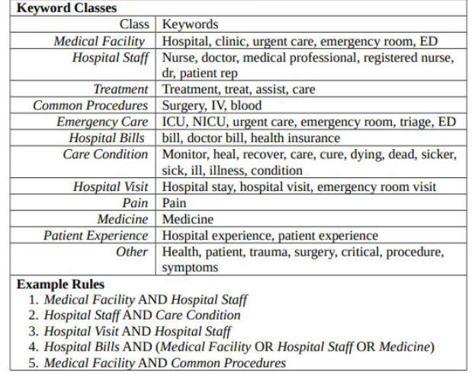
WEB SCRAPING
PATIENT EXPERIENCE TWEET EXTRACTION FOR SENTIMENT ANALYSIS
COLLECT TWEETS DATA WITH
TWITTER API ( library : tweepy, sns)
63239 tweets + 29706 tweets
TWEETS CLEANING:
Remove non English tweets
Hashtags/mentions
URLs
Duplicates/Retweets
Date
TEXT-BASED HEALTHCARE CHATBOT SUPPORTING ADMITTED PATIENTS

Slide 7
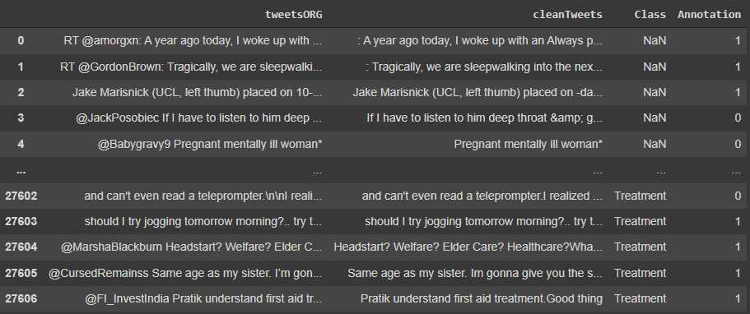
WEB SCRAPING
A glimpse of the final tweet data
28/05/2022
TEXT-BASED HEALTHCARE CHATBOT SUPPORTING ADMITTED PATIENTS

Slide 8
DATA PREPROCESSING AND EDA
PREPROCESSING OF RAW DATA:
Removed the repeated columns which occurred after merging the CSV files of all the Diseases.
Removed Unnecessary data in the Survival_Rate Column for better DATA VISUALIZATION.
Removed the Unwanted Symbols from the Data.
Fixed Some Spelling Mistakes
Added an Extra Column “Condition” to Track the Disease.
28/05/2022
TEXT-BASED HEALTHCARE CHATBOT SUPPORTING ADMITTED PATIENTS

Slide 9
PREPROCESSING THE DATA FOR MODELLING:
Converted long form of contents to short summaries for the better user experience.
Removed the points in each column which an user can’t understand.

Slide 10
NLP SENTIMENT ANALYSIS
ACTIVE LEARNING FOR LABELLING THE DATA AS “RELEVANT” OR “IRRELEVANT”
Manual Annotation of 1.4k tweets
Use of Active learning for text classification into relevant (patient experience) & irrelevant tweets
Libraries: Small-text using Transformer as a classifier
HuggingFace
FILTERING THE DATA TO MAKE THE CORPUS CUSTOMIZED TO THE PROJECT IDEA
The following was the distribution of tweets in the corpus of 62273 tweets
Relevant - 23001
Irrelevant – 39272
The irrelevant tweets were those containing any ads/promotions, government schemes or fund raisers, which were later dropped.
PERFORM SENTIMENT ANALYSIS INTO 3 SENTIMENTS
We used VADER to perform Sentiment Analysis.
The data was classified into 3 sentiments namely:
Positive
Negative
Neutral
28/05/2022
TEXT-BASED HEALTHCARE CHATBOT SUPPORTING ADMITTED PATIENTS

Slide 11
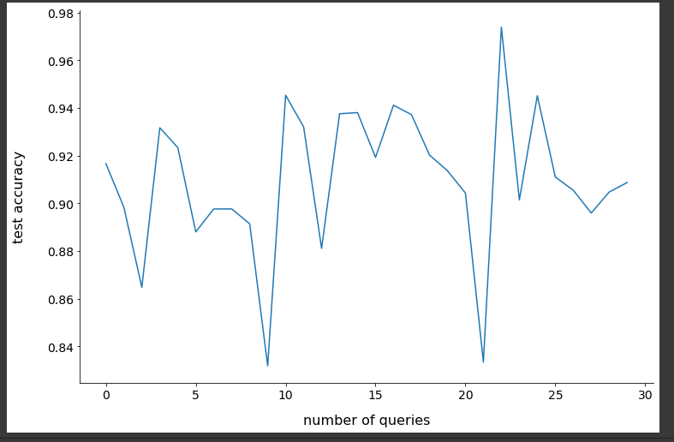
Active Learning graphs

Slide 12
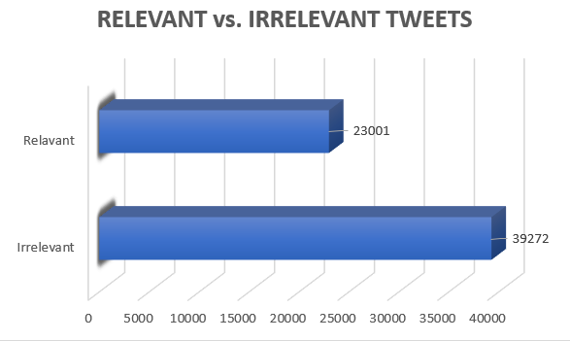
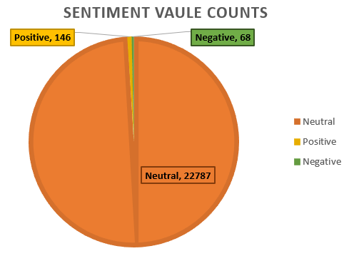
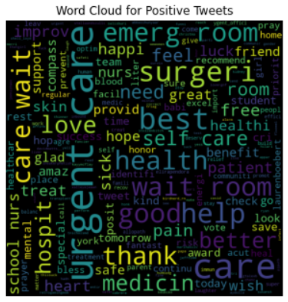
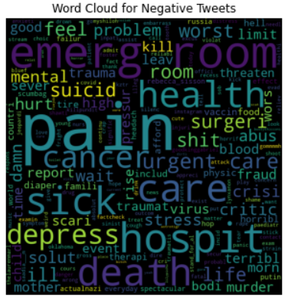
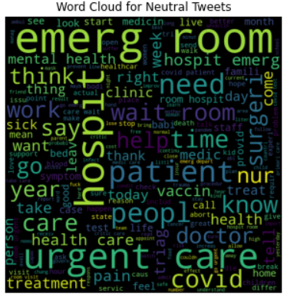

Slide 13
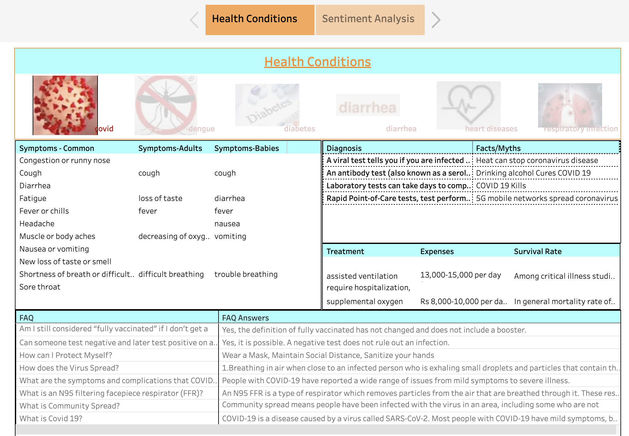
DATA VISUALIZATION

Slide 14
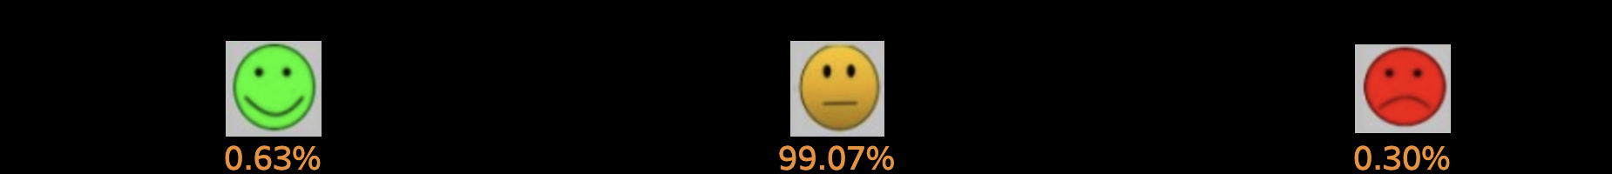
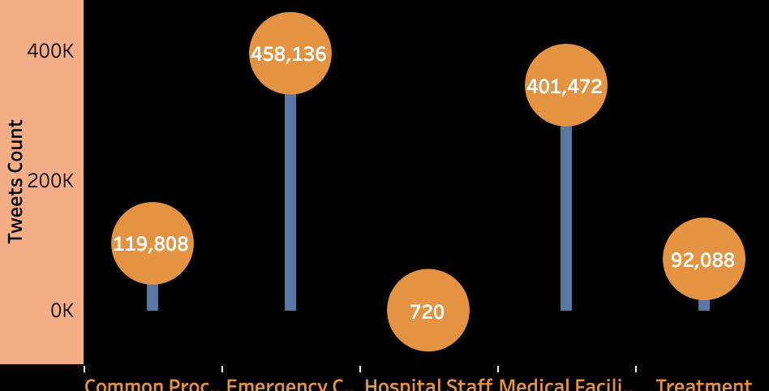
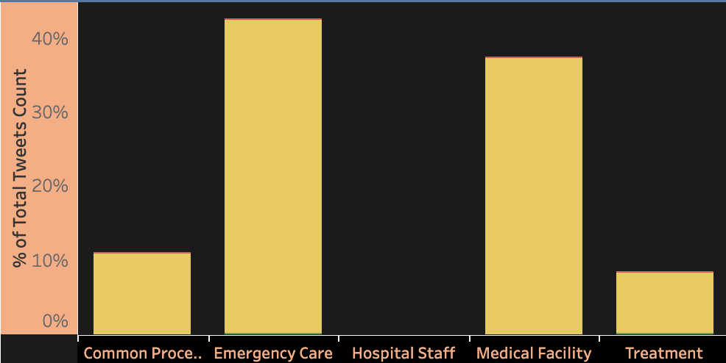
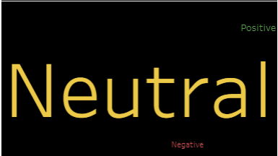
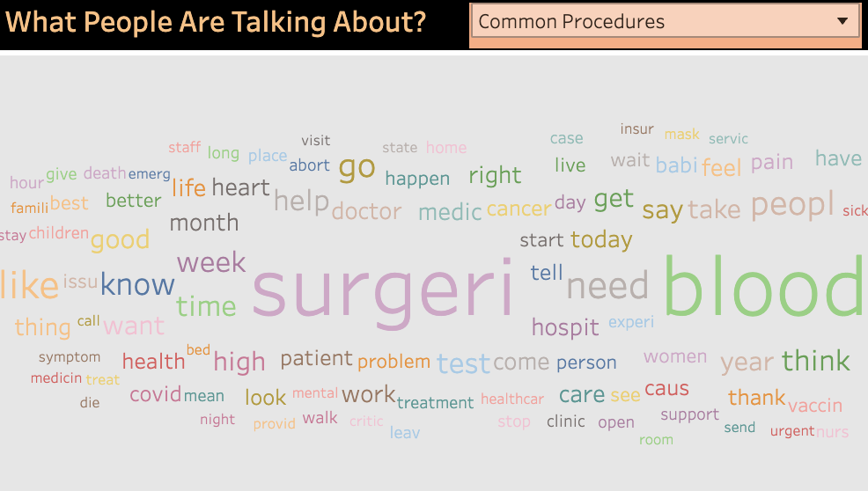

Slide 15
DASHBOARD BUILDING
DASHBOARD DEMO:
Link to the Dashboard: https://public.tableau.com/app/profile/sudhakar.reddy7432/viz/HealthBot/Health?publish=yes
28/05/2022
TEXT-BASED HEALTHCARE CHATBOT SUPPORTING ADMITTED PATIENTS

Slide 16
CHATBOT MODELLING RASA FRAMEWORK
Medical Data
(.csv format)
Rasa is a open source conversational AI tool used to build chatbots. Rasa was chosen for its growing versatility, ease of use and future scalability.
It has four main files to work with, three of which are .yml files and one is actions.py file.
Nlu.yml (User Intents)
Greetings
Symptoms
Medication
Expenses, etc.
Actions.py
nlu.yml
It consists of intents which are basically examples of user inputs. The intents become a part of story line up.
Domain.yml
Intents
Entities
Slots
Responses
Actions
Stories.yml
stories.yml
Stories define a conversational flow for a chatbot. It contains intents as user input and utterances/custom actions as chatbout output
Output
domain.yml
It contains domains to Intents, slots, actions, forms,.etc.
28/05/2022
TEXT-BASED HEALTHCARE CHATBOT SUPPORTING ADMITTED PATIENTS

Slide 17
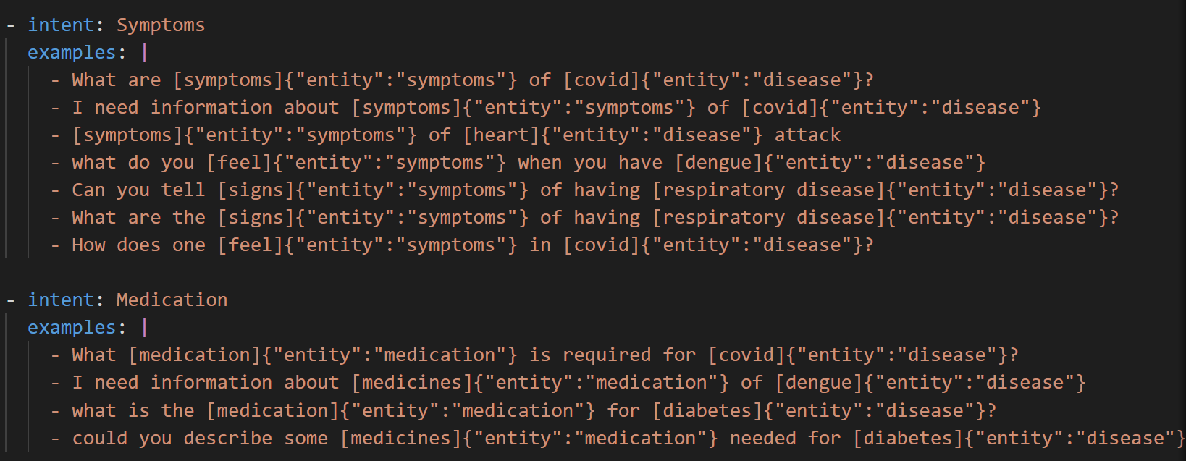
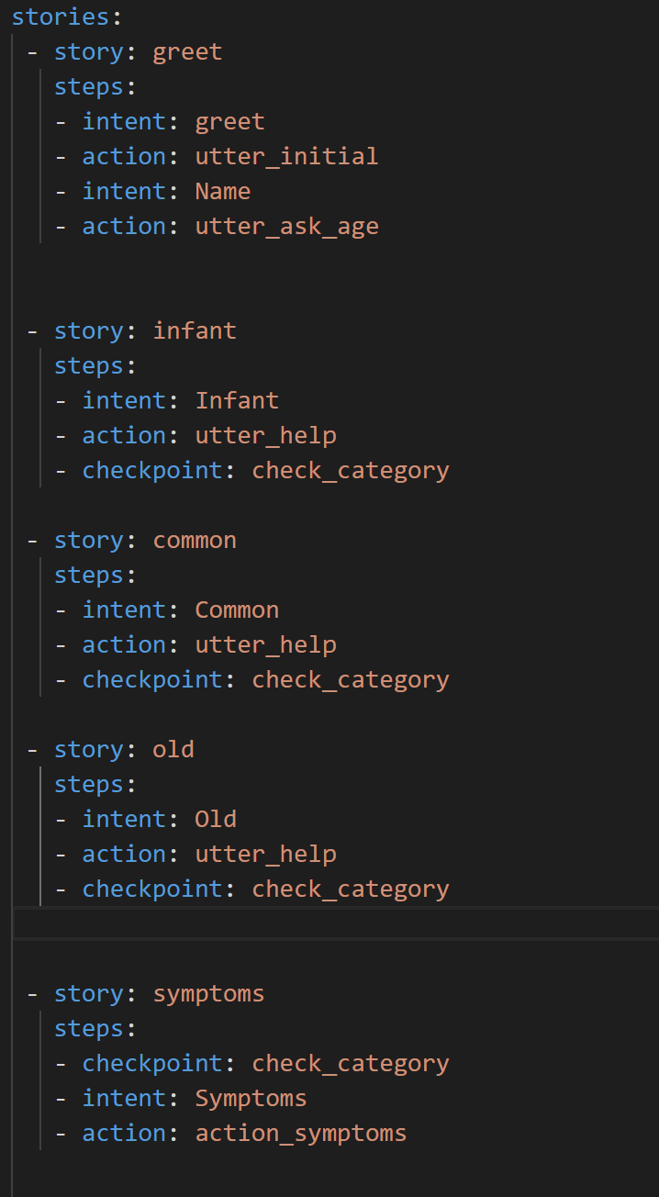
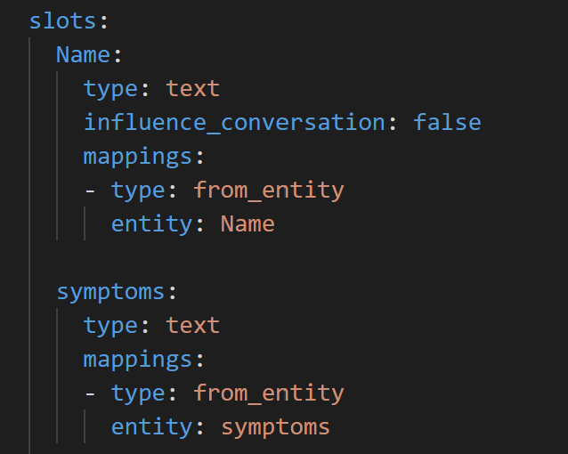
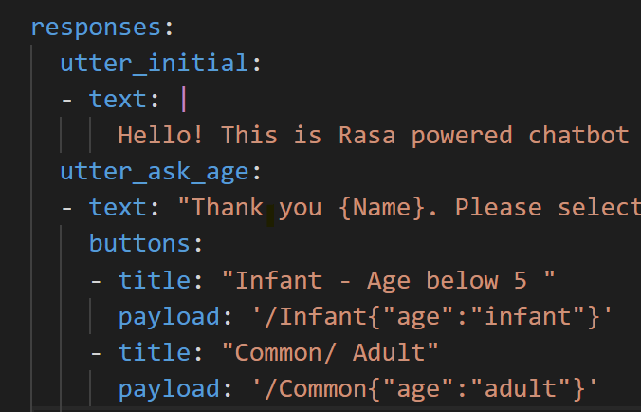
CHATBOT MODELLING RASA FRAMEWORK
Intents
Stories
Domain
Domain
28/05/2022
TEXT-BASED HEALTHCARE CHATBOT SUPPORTING ADMITTED PATIENTS

Slide 18
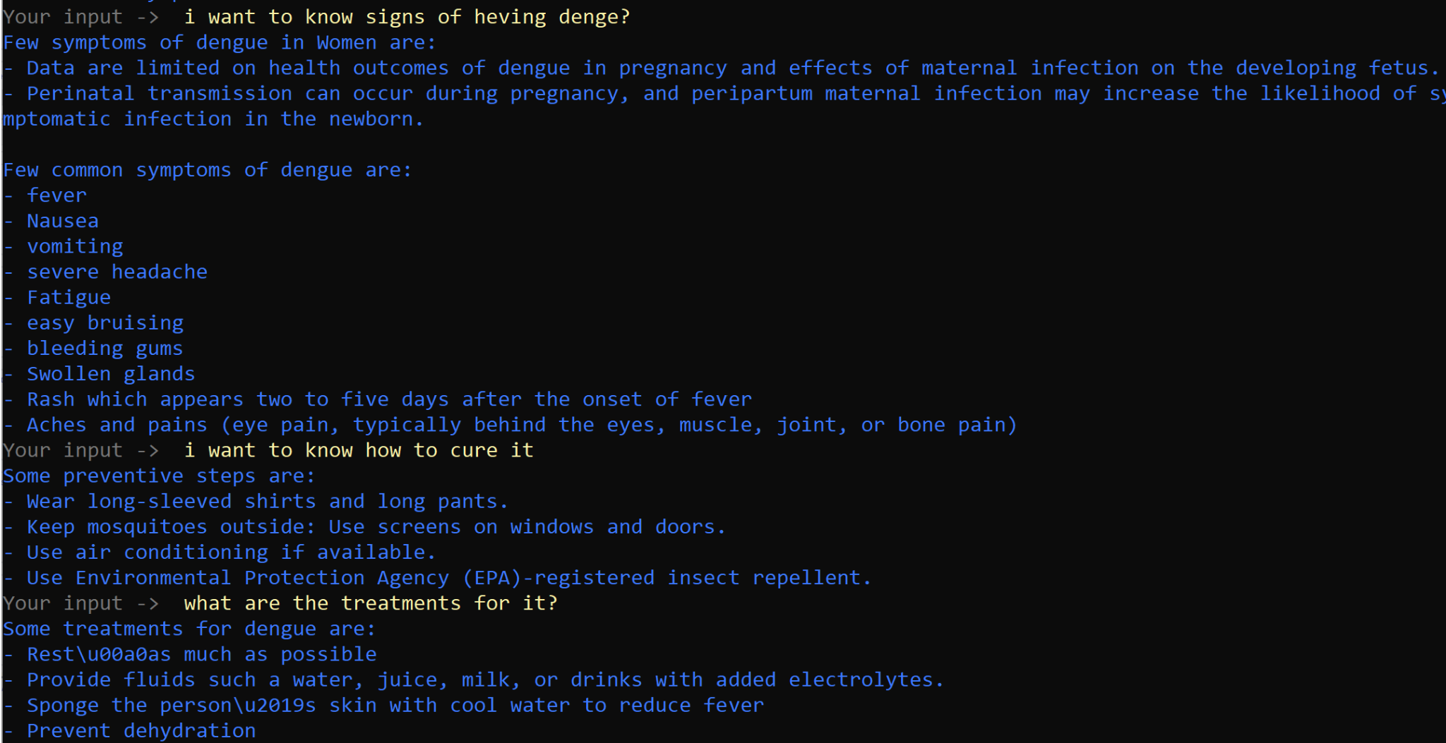
CHATBOT MODELLING RASA FRAMEWORK
28/05/2022
TEXT-BASED HEALTHCARE CHATBOT SUPPORTING ADMITTED PATIENTS

Slide 19
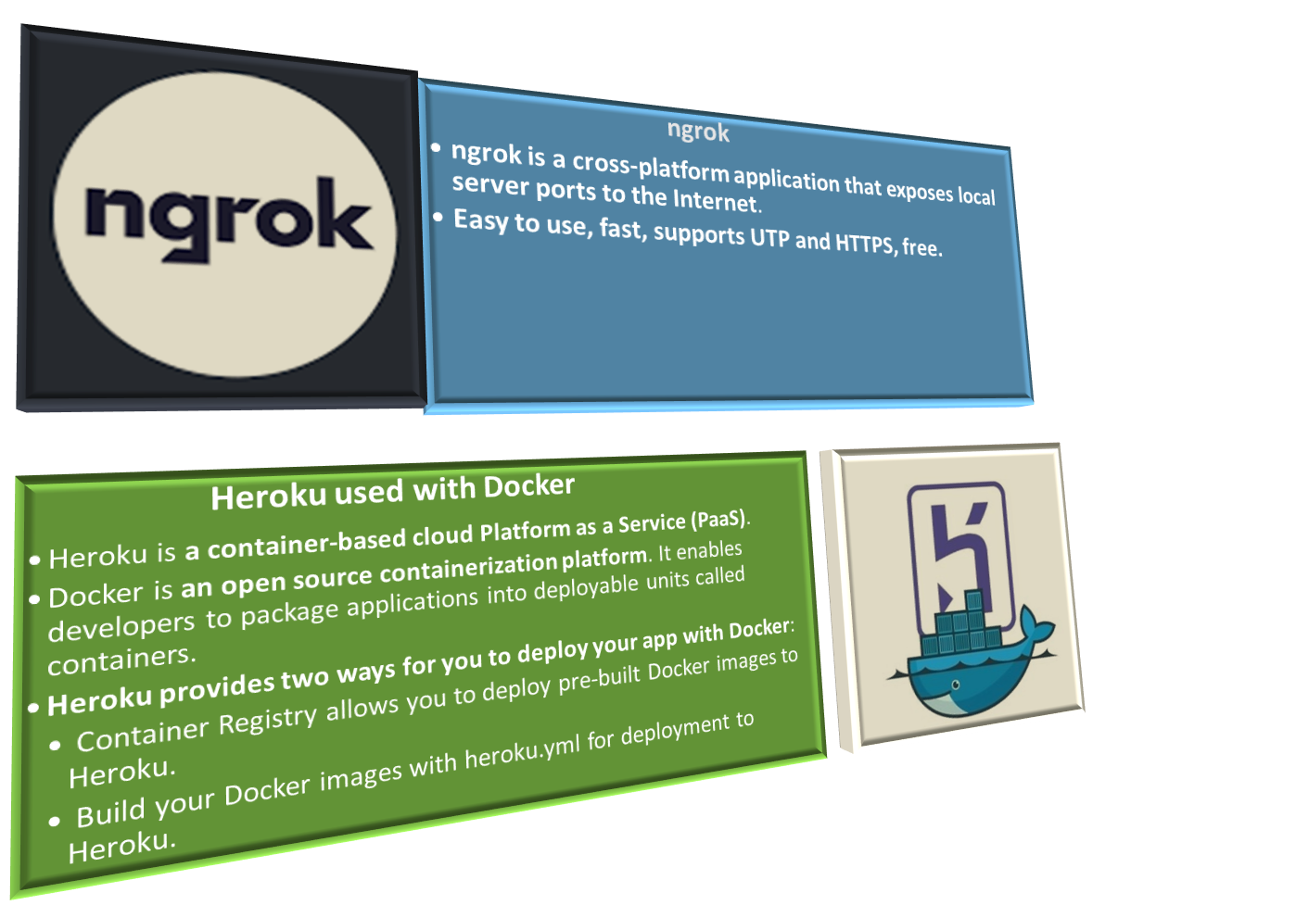
DEPLOYMENT TOOLS
TEXT-BASED HEALTHCARE CHATBOT SUPPORTING ADMITTED PATIENTS

Slide 20
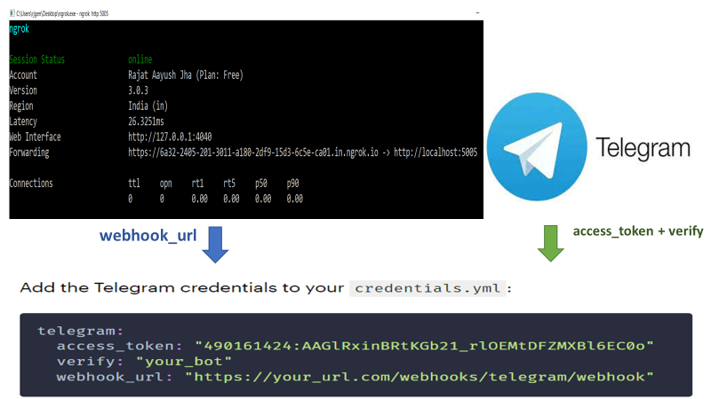
Deployment with ngrok on Telegram channel

Slide 21
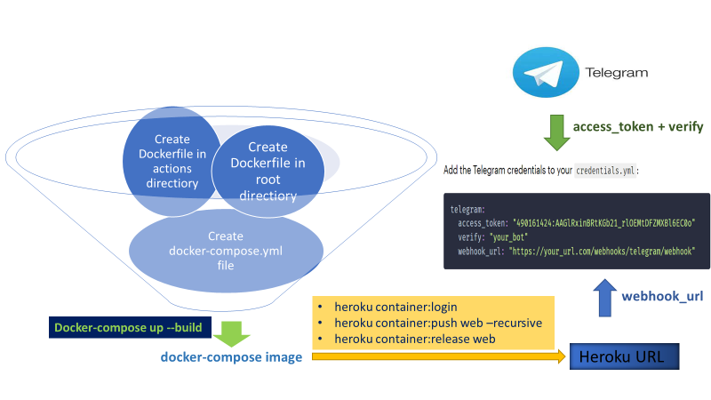
Deployment with Heroku and Docker on Telegram channel

Slide 22
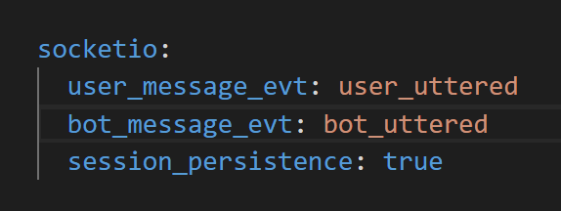
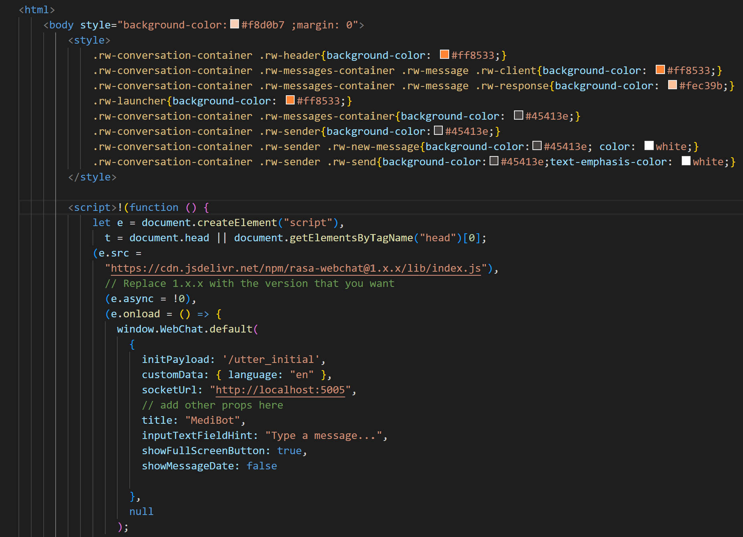
Deployment using Socket IO
We use localhost url that has been used by the root directory of rasa server to connect with socketIO.
Webchat is an open source bot layout provided on github and this has been utilized in this project.
Few html syntaxes are added to change the UI layout and its functions.

Slide 23
CONCLUSION
When the three major outcomes of these projects are implemented at full scale, we could see following benefits:
The chatbot will help users to get the medical/health related information at their fingertips. They don’t need to wait for the doctors or experts from the health field for the answers to general questions.
Additionally, dashboard will also help them to visualize the health and disease related data in real time.
The sentiment analysis provides us with insights on how user’s emotions are classified as positive, negative or neutral. This will help us determine the level of stress, anxiety and nervousness among patients/users and eventually help to reduce it by first two points discussed above.
28/05/2022
TEXT-BASED HEALTHCARE CHATBOT SUPPORTING ADMITTED PATIENTS

Slide 24
POTENTIAL NEXT STEPS
Hit count of how often the chatbot has delivered a certain piece of information, as this will assist the administration defend why we picked specific ailments for our dataset.
Incorporate sentiment analysis into the chatbot to respond to patient enquiries based on the sentiment of the preceding remark or query.
Adding more database of diseases and its related attributes.
28/05/2022
TEXT-BASED HEALTHCARE CHATBOT SUPPORTING ADMITTED PATIENTS

Slide 25
REFERENCES
Upper Respiratory Infection: Symptoms, Contagious, Treatment
About Heart Disease | cdc.gov
Your Health | COVID-19 | CDC
Diabetes Rash: Causes, Appearance and Prevention
Diabetes - Symptoms and causes - Mayo Clinic
Upper Respiratory Infection: Symptoms, Contagious, Treatment
FAQs on Heart Health — Vikaspedia
Acute Upper Respiratory Infection
GitHub - botfront/rasa-webchat: A feature-rich chat widget for Rasa and Botfront
Date
TEXT-BASED HEALTHCARE CHATBOT SUPPORTING ADMITTED PATIENTS

Slide 26
OUR TEAM
● Rajat Aayush Jha
● Hardik Seju
● Bharati Panigrahi
● Sumanth Reddy
● Nikki Amurao
● Sai Phani Parsa
● Ruchi Sharma
● Madhu Prasath
● Esha Priyadarshi
● Sudhakar Reddy
● Priyank Negi
● Nica Medrano
● Bharat Raghunathan
● Ameen Shaikh
● Varanasi Akshay Kumar

Slide 27
CHAPTER CO-LEADS:-
NIKHIL SHRESTHA
PRATHIMA KADARI
CHAPTER LEAD:-
MUHAMMAD YAHIYA
THANK YOU

